Slide 1

Predictive Analysis of Parkinson's Disease from Gait Sensor Data and Brain MRI Images
CS799 PROJECT- II
Department of Computer Science and Engineering
Indian Institute of Technology, Ropar
Instructor:
Dr. Deepti R. Bathula:
Assistant Professor
Department of Computer Science & Engineering
Presented By:
Arunava Chaudhuri (2021CSM1020)

Slide 2
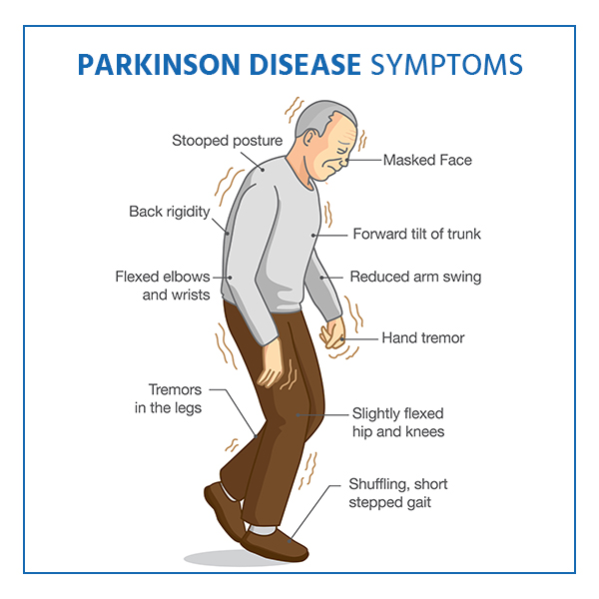
Contents :
Introduction
Problem Statement
Literature Review
Datasets
Phase 1 Summary
Multi-Model Analysis
Result
Model Comparison
Future Development
Conclusion
Source: https://www.parkinsonsnsw.org.au/symptoms-and-complications/

Slide 3
Introduction :
Parkinson’s Disease: Neurodegenerative movement disorder.
Symptoms: Tremor, Slowed movement, Rigid muscles.
Challenges in diagnosing PD.
Machine Learning: Contribution towards diagnosis.
Multi-modal Data: Combination of image data and clinical data.

Slide 4
Problem Statement :
“Enhancement of PD diagnosis and early detection using Multi-modal data.”
Combine Gait analysis data features with PPMI data.
Create a end to end Multi-Modal architecture
Validate and optimize the model.
Reduce error rate in diagnosis.
Compare with previous experiment on Gait and PPMI data.

Slide 5
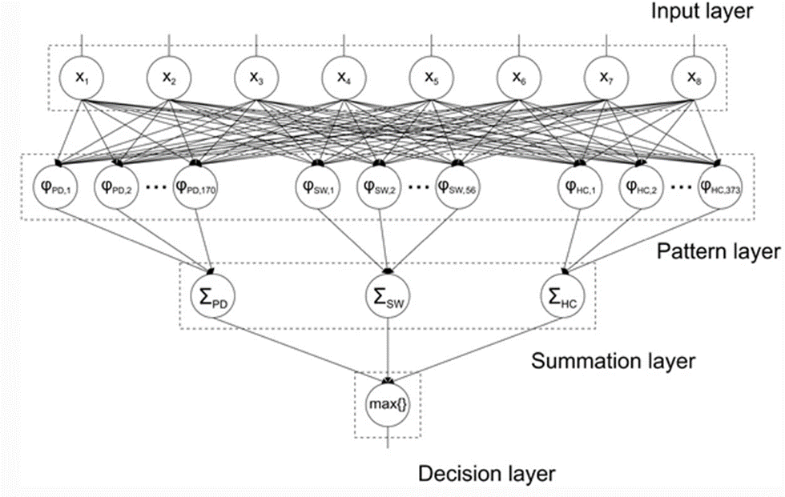
Literature Review :
Machine-learning-based approaches to the diagnosis of PD mainly fall into three categories:
Discrimination between PD and Healthy control (HC)
Computer-aided diagnosis of Parkinson’s disease using enhanced probabilistic neural network

Slide 6
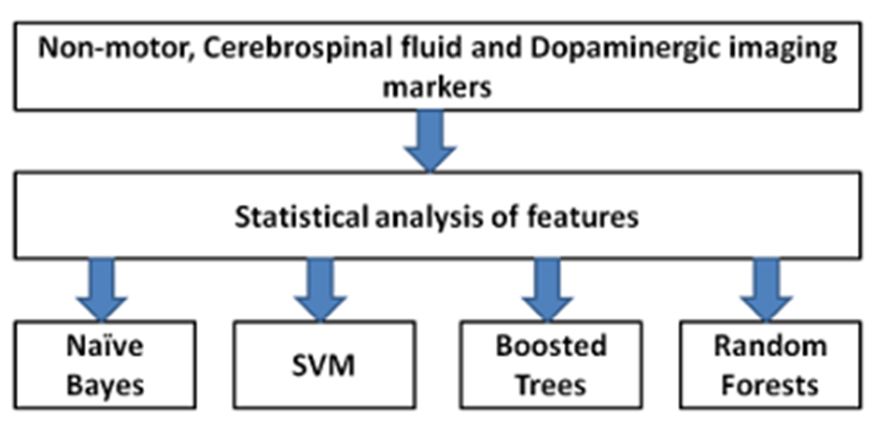
Literature Review (Contd.) :
Integrative analysis of blood metabolomics and PET brain neuroimaging data for Parkinson’s disease.
High-Accuracy detection of early Parkinson’s disease through multimodal features and machine learning.
Flowchart of the proposed analysis

Slide 7
Literature Review (Contd.) :
Differential diagnosis
Magnetic resonance support vector machine discriminates between Parkinson’s disease and progressive supranuclear palsy.
Combined diffusion tensor imaging and apparent transverse relaxation rate differentiate Parkinson’s Disease and Atypical Parkinsonism.

Slide 8
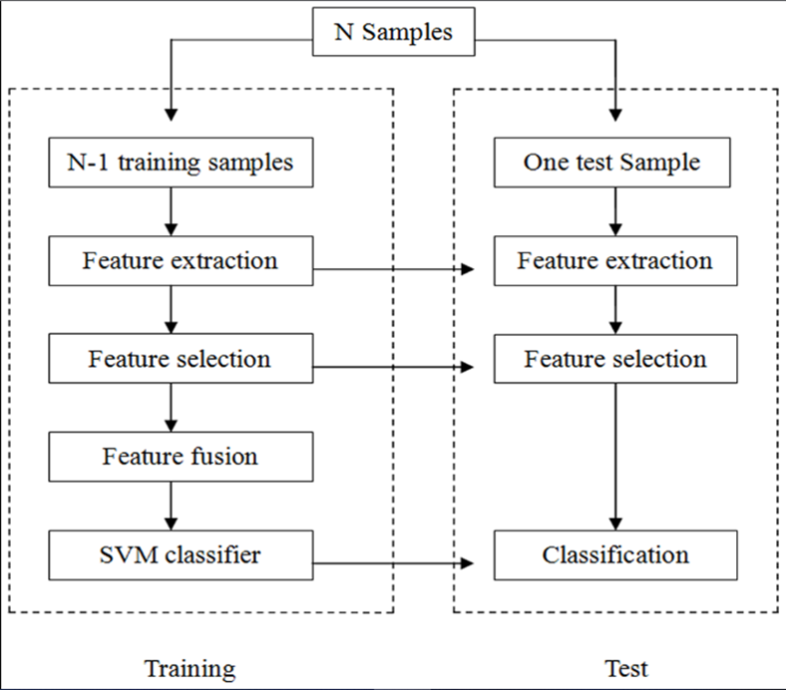
Literature Review (Contd.) :
Early PD detection
Automatic classification of early Parkinson’s disease with multi-modal MR imaging.
Flowchart of the multi-model method for classification.

Slide 9
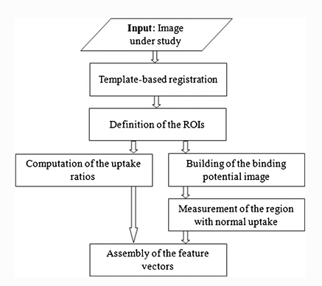
Literature Review (Contd.) :
Early PD detection
Extraction, selection, and comparison of features for an effective automated Computer-aided diagnosis of Parkinson’s disease based on [123I]FP-CIT SPECT images.
Flow diagram for the quantification of an [123I]FP-CIT SPECT brain image.

Slide 10
Datasets :
Gait Analysis Data
Physionet Gait Database: Measures of gait from 93 patients with idiopathic PD and 73 healthy controls.
Image and Clinical Data
Parkinson's Progressive Markers Initiative: To identify biomarkers of Parkinson’s disease (PD) onset and progression — a critical next step in the development of new and better treatments for PD.

Slide 11
Phase 1 Summary :
Explored the gait analysis data.
Trained a CNN model only with gait data.
Classified the Gait data with an accuracy of more than 87%.
Observe data distribution of the PPMI dataset.
Experimented PPMI dataset on different ML models.
Neural Network model generates higher classification accuracy of 92%.

Slide 12
Multimodal Analysis :
(a) Data Preparation :
Used statistical approach (e.g. Minimum, Maximum, Mean, Median, Standard Deviation, Skewness, and Kurtosis ) to transform Gait data
Original Gait features transformed into 19x7=133 features corresponding to each subject.
Considered 7 visits data along with baseline visit for PPMI data which gives 1597 features.
Separated both the data based on each class distribution.

Slide 13
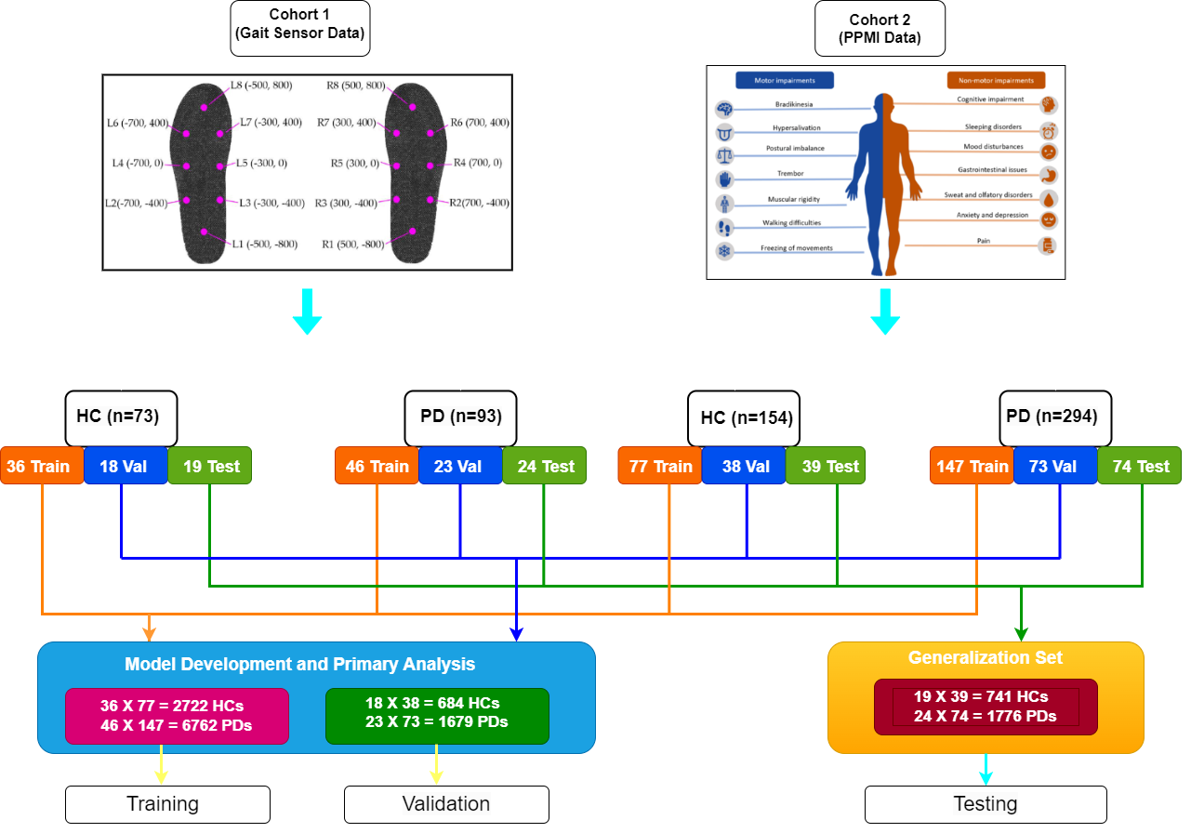
(b) Data Generation :
Data Generation Diagram

Slide 14
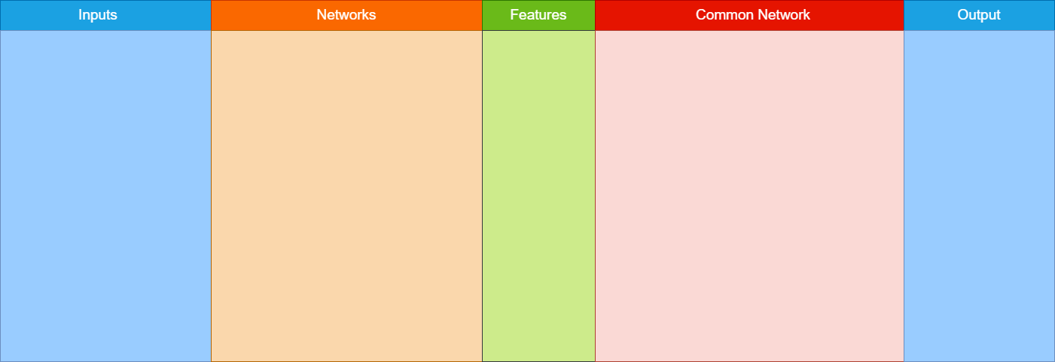
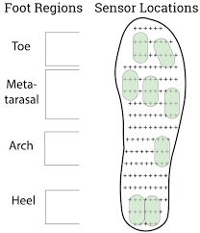
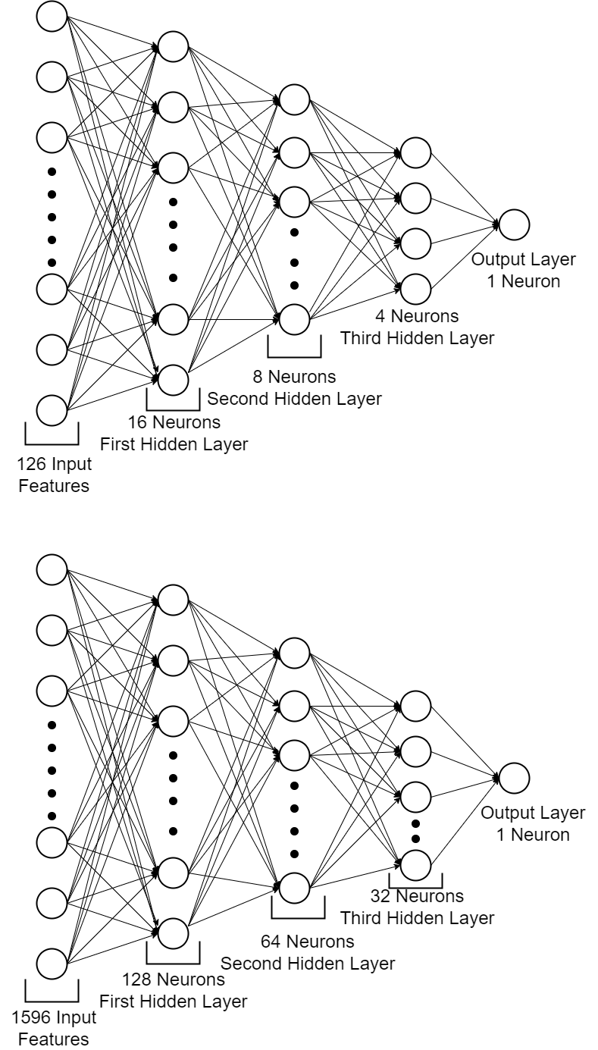
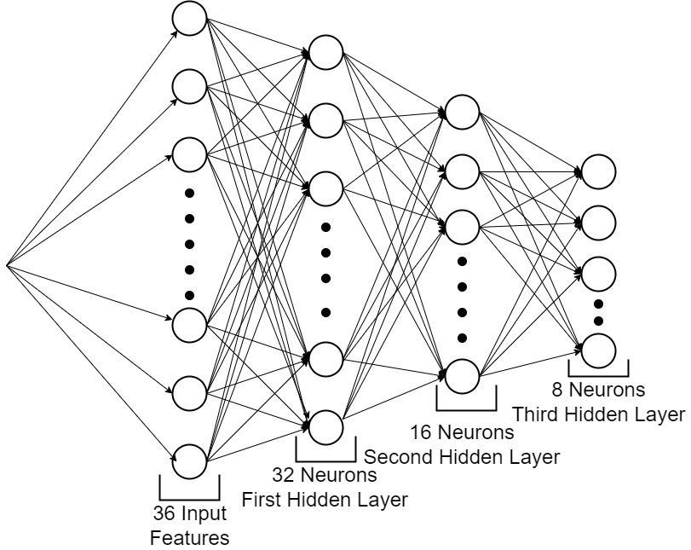
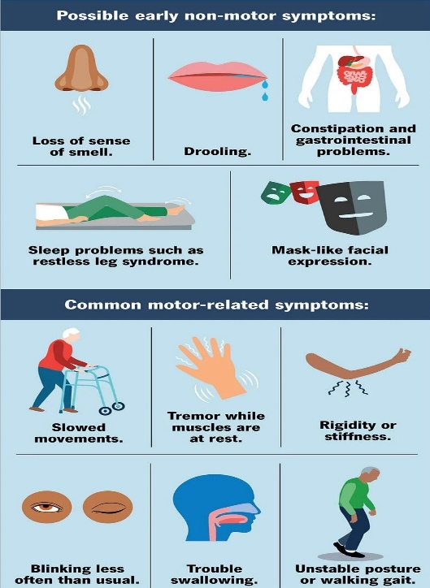
(b) Multimodal Siamese Network:
Gait Network
Siamese Network
Features Concatenation
Gait Network Features
+
PPMI Network Features
PPMI Network
Feature Vectors for Combined Data

Slide 15
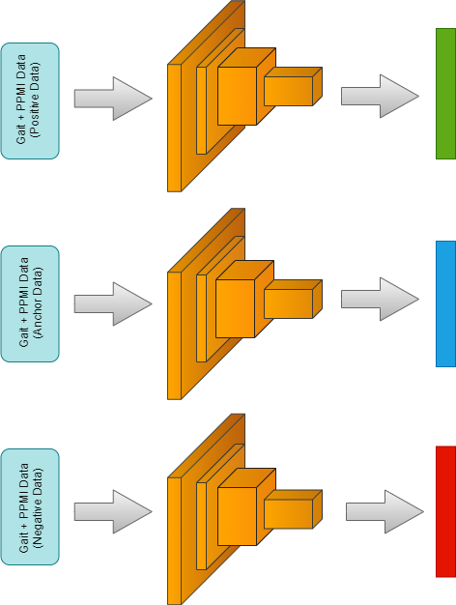








(c) Triplet Loss Model:
Embedding Space
$$x_{p}$$
$$f(x_{P})$$
$$d_{p} =d\left({f(x}_{a}\right),f(x_{p}))$$
$$d_{n} =d\left({f(x}_{a}\right),f(x_{n}))$$
$$x_{a}$$
$$f(x_{a})$$
$$L_{triplet} ={[d_{p} − d_{n}+ α]}_{+}$$
$$x_{n}$$
$$where {[z]}_{+}=max⁡(z,0)$$
$$f(x_{n})$$

Slide 16
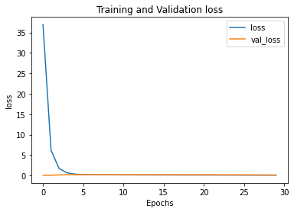
(d) Result using Triplet Loss:
Training vs validation loss graph using Triplet loss function
Similarity on combined test data.
Negative Similarity : 0.9735021
Positive Similarity : 0.9833172

Slide 17
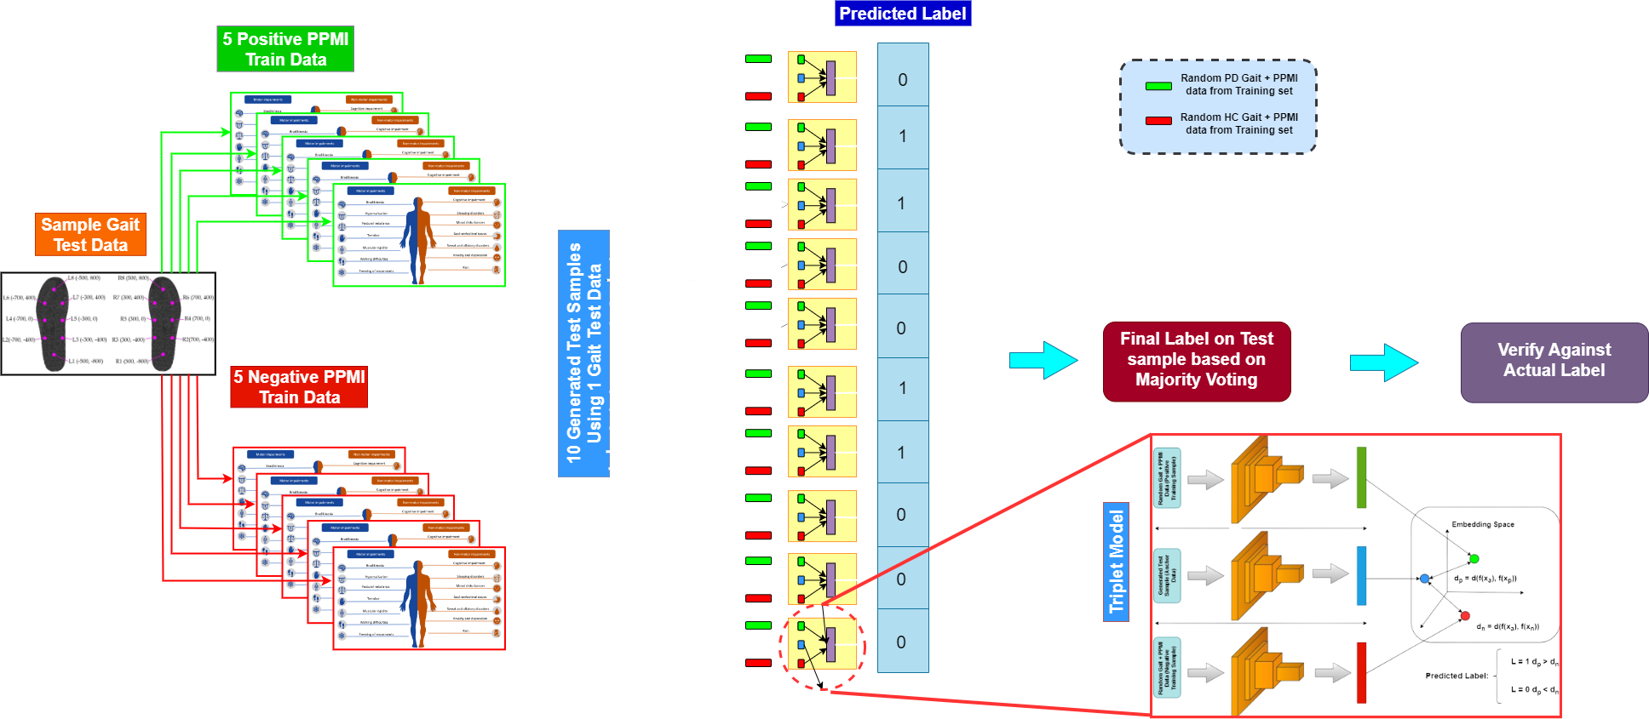
(e) Experiment on Test Dataset:
Training vs validation loss graph using Triplet loss function

Slide 18
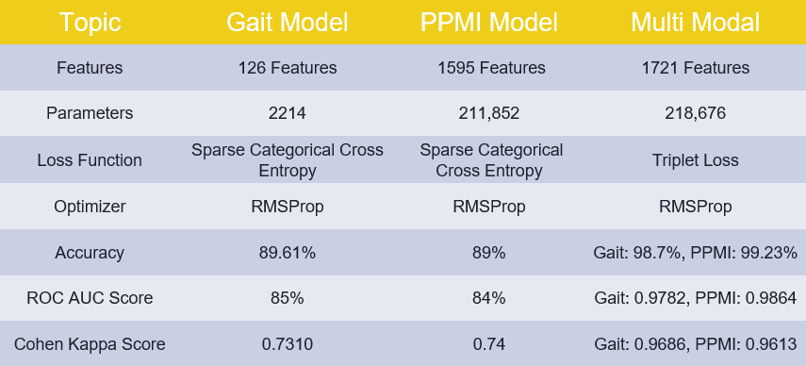
Multi-Modality vs Single Modality Comparison :

Slide 19
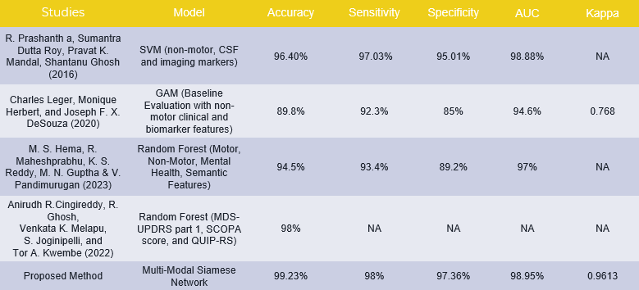
Previous Research Comparison on PPMI Data :

Slide 20
Previous Research Comparison on Gait Data :
Authors | Accuracy | Sensitivity | Specificity | F1 Score
Zeng et al. (2016) | 98.8 | 98.92 | 98.63 | NR
Açici et al. (2017) | 98 | 99.1 | 95.7 | 0.98
A¸suro˘glu et al. (2018) | 99 | 97.8 | 99.5 | NR
Zhao et al. (2018) | 98.61 | NR | NR | NR
Noella et al. (2019) | 97 | NR | NR | NR
Veeraragavan et al. (2020) | 97.7 | 97.05 | 97.41 | 0.97
Xia et al. (2020) | 99.07 | 99.1 | 99.01 | NR
Priya et al. (2020) | 98.82 | NR | NR | NR
Ghaderyan and Fathi (2021) | 97.22 | 98.22 | 95.86 | NR
Liu et al. (2021) | 99.22 | 98.04 | 100 | 0.99
Tong et al. (2021) | 99.23 | NR | NR | NR
Proposed Method | 99.2 | 98.52 | 100 | 0.99

Slide 21
Future Development:
It can be extended towards classifying other serious diseases.
Adding more PPMI clinical diagnosis data.
Experiment with other fusion technique.
Better representation of Gait sensor Data.

Slide 22





Timeline :
STAGE 01
(Oct - Nov)
Continuing work on the Gait and PPMI datasets to observe individual accuracy.
STAGE 03
(Jan - Feb)
Build Multi-Modal structure and try to feed the combined dataset to the model.
STAGE 02
(Dec)
STAGE 04
(Mar - Apr)
STAGE 05
(May)
Validate error rate and accuracy on real time test data.
Report writing and Presentation.
Work on combining features from two different modalities.
(Completed)
(Completed)
(Completed)
(Completed)
(Completed)

Slide 23
Conclusion:
Experiment on Multi-Modal analysis based on Learned Feature fusion technique.
An Experiment on using features coming from different subjects.
An idea against the problem of missing modalities.
Successful in terms of reducing misclassification of data.
Achieved better AUC and sensitivity.

Slide 24
References:
Cherubini and A. et al. Magnetic resonance support vector machine discriminates between parkinson’s disease and progressive supranuclear palsy.
Glaab et al. Integrative analysis of blood metabolomics and pet brain neuroimaging data for parkinson’s disease.
H. Hirschauer et al. Computer-aided diagnosis of parkinson’s disease using enhanced probabilistic neural network.
D. et al. Long. Automatic classification of early parkinson’s disease with multi-modal MR imaging.
Oliveira et al. Extraction, selection and comparison of features for an effective automated computer-aided diagnosis of parkinson’s disease based on [123i]fp-cit spect images.
R Prashanth et al. Highaccuracy detection of early parkinson’s disease through multimodal features and machine learning.

Slide 25
Thank You

